Slide 1
Lecture 4 Dimensionality Reduction & VC Dimension
CS582
Machine Learning: Getting Computers
to Program Themselves
“Discovering the Learning Dynamics of the Laws of Nature”
Dr. Emdad Khan
ekhan@miu.edu
Dept. of Computer Science
Maharishi International University

Slide 2
Dimensionality Reduction: The Need
When we have more dimensions (i.e. more features), we need larger number of input neurons (as well as more hidden neurons in general) and hence more weights.
More dimensions mean more training data.
More dimensions also mean more computation.
From visualization standpoint we cannot see if the dimension is over 3. And 2D is better for viewing.
Thus, reducing dimensions is the Key from multiple standpoints.

Slide 3
Curse of Dimensionality -1
To better understand the need to reduce dimensions, let’s take a look from a mathematical angle:
As the number of dimensions increases, the volume of the unit hypersphere does not increase with it.
The unit hypersphere is the region we get if we start at the origin (the center of our coordinate system) and draw all the points that are distance 1 away from the origin.
In 2D it is a circle, in 3D it is a sphere and in higher dimensions it is a hypersphere (Fig. next slides).

Slide 4
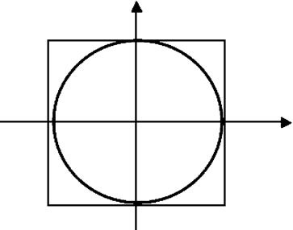
Curse of Dimensionality - 2
FIGURE 2.2 The unit circle in 2D with its bounding box.
The unit circle in 2D with its bounding box (Diameter is 2 {coordinates [-1,1]}). Circle area does not cover the whole area of the bounding box.

Slide 5
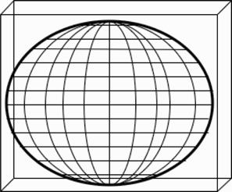
Curse of Dimensionality - 3
FIGURE 2.2 The unit circle in 2D with its bounding box.
The unit sphere in 3D with its bounding box (Diameter is 2 {coordinates [-1,1]}). The sphere does not cover the whole volume of the bounding box.

Slide 6
Curse of Dimensionality - 4
FIGURE 2.2 The unit circle in 2D with its bounding box.
Dimension | Volume
1 | 2.0000
2 | 3.1416
3 | 4.1888
4 | 4.9348
5 | 5.2636
6 | 5.1677
7 | 4.7248
8 | 4.0587
9 | 3.2985
10 | 2.5502

Slide 7
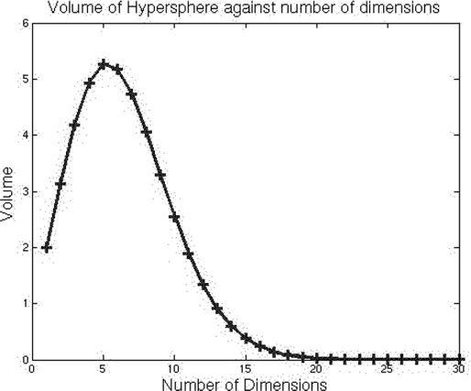
Curse of Dimensionality - 5
FIGURE 2.2 The unit circle in 2D with its bounding box.

Slide 8
Curse of Dimensionality - 6
FIGURE 2.2 The unit circle in 2D with its bounding box.
The volume of the hypersphere of dimension n is calculated using standard formula
v_{n} = (2π/n)v_{n−2}.
As soon as n > 2π, the volume starts to shrink.
When the number of dimensions is above about 20, the volume is effectively zero.
Considering all factors, we are better off if we can have number of dimensions not exceeding 3.

Slide 9
How to Reduce Dimensionality?
There are 3 broad ways:
Feature Selection - looking through the features that are available and seeing whether or not they are actually useful,
i.e. correlated to the output variables.
Feature derivation - deriving new features from the old ones, generally by applying
transforms to the dataset that simply change the
axes of the graph by moving and rotating
them.

Slide 10
How to Reduce Dimensionality?
Feature derivation achieves dimensionality reduction as it combines features and identifies which are useful and which are not.
Clustering - group together similar data points, and see whether this allows fewer features to be used.
To see how choosing the right features can make a problem significantly simpler, look at the fig. (next slide) -

Slide 11
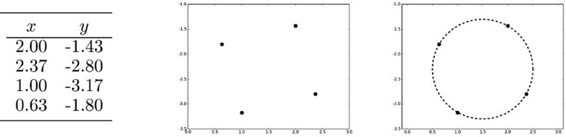
Correct Representation is Key
Three views of the same four points. Left: As numbers, where the links are unclear. Center: As four plotted points. Right: As four points that lie on a circle (preferred one), and hence can be described by an angle (pi/6, 4pi/6, 7pi/6,11pi/6) i.e. reducing from 2D to 1D.

Slide 12
Feature Selection – Some Notes
We will show another method of Feature Selection when we will cover Decision Tree.
Feature selection is actually a search problem. Hence can be computationally very expensive since for d features there are 2^{d} − 1 possible sets of features to search over.
Hence usually a Greedy method is used.
We will cover Dimensionality Reduction using both Supervised and Unsupervised learning.

Slide 13
LDA: Uses Supervised Learning Approach
Linear Discriminant Analysis (LDA) is an statistical method that uses mean and covariance to determine within-class and between-class scatters and use those to project on different axes that allows classes to be well separated.
Fig. 6.2 (next slide) shows dataset for two classes (Note data must be labeled as LDA uses Supervised Learning).
Fig 6.3 shows the meaning of the between-class and within-class scatters.
Equations to calculate the scatters are shown in the following slides.

Slide 14
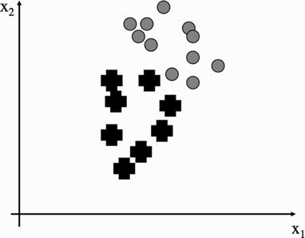
Figures for Data
FIGURE 6.2 A set of data points in two dimensions, with two classes.

Slide 15
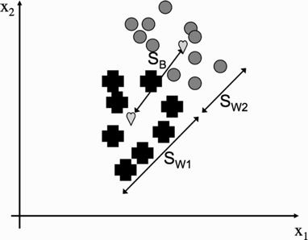
Figures for Data
FIGURE 6.3 The meaning of the between-class and within-class scatters. The hearts mark the means of the two classes.
.

Slide 16
Key Equations
Scatters are calculated using the means, co-variances and probabilities as shown below.
Our goals is to maximize Sb / Sw so that we have good separation between classes.
.

Slide 17
Finding Best Value for Sw / Sb - 1
Note that any line can be written as a vector w which we used as our weight vector.
The projection of the data can be written as z = wT · x for data point x.
This gives us a scalar that is the distance along the w vector
that we need to go to find the projection of point x.
So we can compute the projection of our data along w for every point, and we will have projected our data onto a straight line (Fig. 6.4 – next slide).
We now use these projections to update equations 6.1 and 6.2 (which includes W) and then optimize W (by differentiation) that will provide maximum Sb / Sw. Data is then represented in 1D from original 2D -> hence Dim. Reduction. It also helps classification: next slide – right Fig..
.

Slide 18
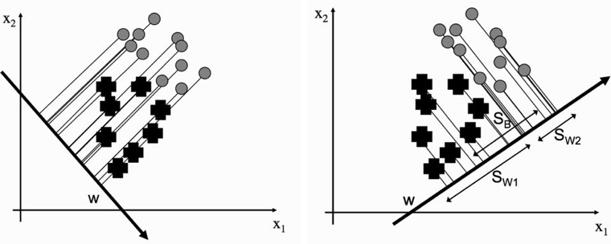
Finding Best Value for Sw / Sb - 2
FIGURE 6.4 Two different possible projection lines. The one on the left fails to separate the classes.
Data is then represented in 1D from original 2D -> hence Dim. Reduction. It also helps classification (right figure).
.

Slide 19
Finding Best Value for Sw / Sb - 3
Replacing xj with wT · xj in Equations (6.1) and (6.2) we can use some linear algebra (principally the fact that (A^{T} B)^{T} = B^{T} A^{TT} = B^{T}A) to get:
.

Slide 20
Finding Best Value for Sw / Sb - 4
Now the optimal value of W is obtained by differentiating the ratio of equation 6.4 to 6.3 and setting it to 0.
The details are skipped as all these can be done easily in Python – see code in the next slide.
Unfortunately, finding the optimum is not simple, and requires computing the generalized eigenvectors of S⁻¹W S_{B}, assuming that S⁻¹W exists.
The next algorithm (PCA) usually works better even though it is mainly planned for unsupervised learning.

Slide 21
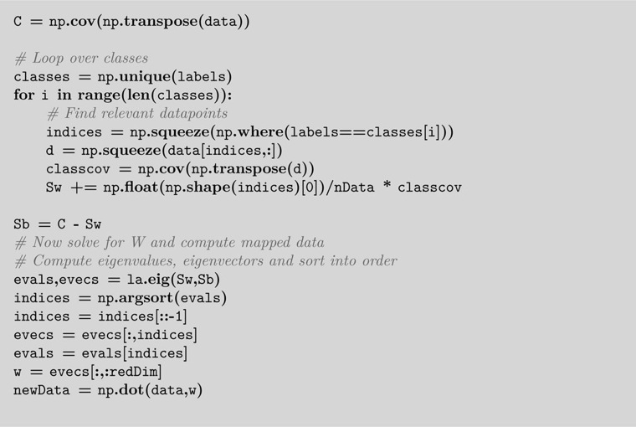
Python Code for LDA

Slide 22
Principal Components Analysis (PCA)
The key idea of PCA is to find a specific set of axes that minimizes the number of dimensions.
To understand this, let’s take a look at Fig. 6.6 (next slide).
In the first the data are arranged in an ellipse that runs at 45° to the axes.
In the second the axes have been moved so that the data now runs along the x–axis and is centered on the origin.
The y dimension does not now demonstrate much variability – and hence can be ignored (i.e. dimensionality reduction)

Slide 23
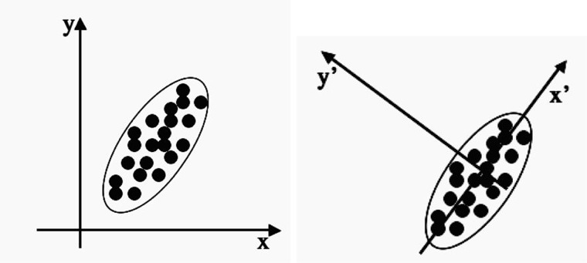
PCA Concept Using Proper Axes
FIGURE 6.6 Two different sets of coordinate axes. The second consists of a rotation and translation of the first and was found using Principal Components Analysis.

Slide 24
PCA Algorithm
The key question is how to find the axes.
The algorithm first centers the data by subtracting off the mean. Then chooses the direction with the largest variation and places an axis in that direction.
It then looks at the variation that remains and finds another axis that is orthogonal to the first and covers as much of the remaining variation as possible.
The process is repeated until it has run out of possible axes.

Slide 25
PCA Algorithm
The end result is that all the variation is along the axes of the coordinate set, and so the covariance matrix is diagonal—each new variable is uncorrelated with every variable except itself.
This means that the algorithm uses various matrix manipulations to find the optimal axes.
In more formal terms, we have a data matrix X and we want to rotate it so that the data lies along the directions of maximum variation.
We basically multiply our data matrix by a rotation matrix (often written as P^{T}) so that Y = P^{T} X, where P is chosen so that the covariance matrix of Y is diagonal (next slide).

Slide 26

PCA Algorithm
This can be achieved by using various matrix manipulations which is omitted here for simplicity. Basically P is shown as the Eigen vector of Covariance of X matrix.
The Python Code (next slide implement the same in a simpler way).

Slide 27
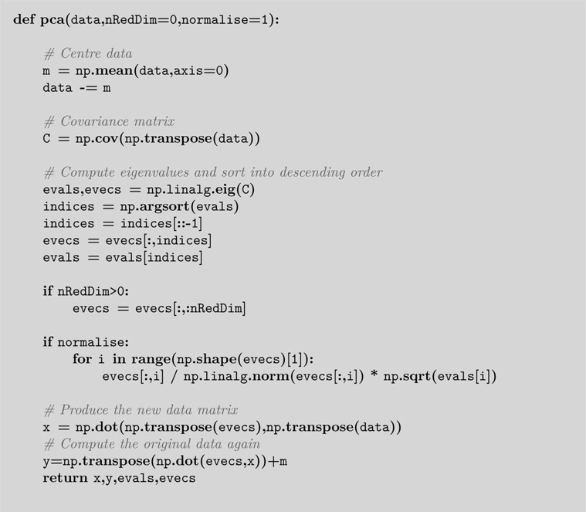
Python Code for PCA

Slide 28
PCA – Some Final Notes
PCA is basically linear – it just rotates and translates the axes. It cannot do anything more complicated.
However, there are ways to deal with nonlinear cases e.g. using Kernel Trick in SVM (Support Vector Machine – not covered).
There is a relation between PCA and MLP. Refer to the auto-associative MLP we discussed before. The hidden layer represented the input in a compressed way. That is basically similar to what PCA is doing.

Slide 29
VC Dimension
We have seen that ML can learn how to classify.
A natural question is how many things it can classify? This will provide the Capacity of learning.
Another related thing is how good it can generalize?
VC-Dimension (developed by Vapnik–Chervonenkis in early 90s) basically measures the learning capacity.
It is defined as the cardinality of the largest set of points that the algorithm can shatter.
It is a core concept in Vapnik–Chervonenkis theory, and was originally defined by Vladimir Vapnik and Alexey Chervonenkis.
Let’s use a figure to understand this more clearly (next slide).

Slide 30
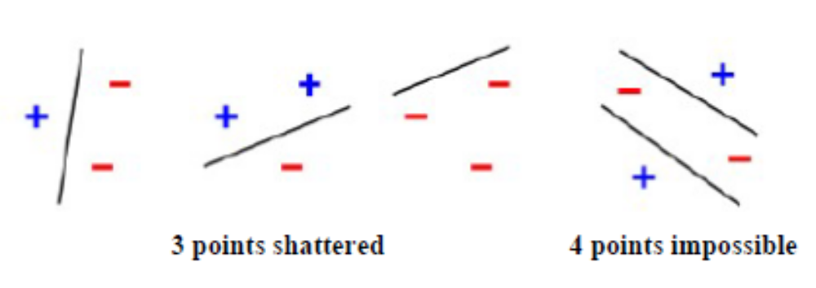
VC Dimension
Consider Perceptron where a straight line used as a classification model on points in a two-dimensional plane. The line should separate positive data points from negative data points.
Figure below shows that 3 points can be shattered / classified by a line but not 4. So, the VC Dimension is 3 in this case.
Note, only 3 of the 2³ = 8 possible label assignments are shown for the three points.

Slide 31
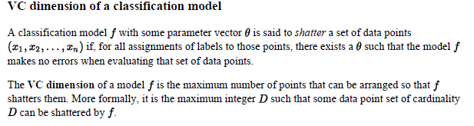
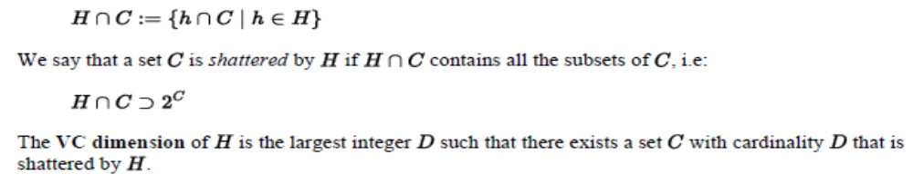
VC Dimension – Shatter
Here, we can think “f” as a linear function as in Perceptron or a nonlinear function in MLP that can learn how to classify input data into desired classes. Total # of possible “f”s is the capacity.
VC Dimension of a Set Family

Slide 32
VC Dimension – Neural Nets -1
We are just sharing some results and skipping some complex math to derive
the VC Dimension (VCd), and
the number of functions that a neural net can learn (the capacity, C).
The capacity C is related to the VCd and number of training samples, N (which is also related to the weights)
For Perceptron, C = 2^{N} if N < m; otherwise, it is
less than 2^{N.}
The VCd for Perceptron is m +1, where m is the dimension of the input vector (1 is for the bias).
Thus, if we use more training examples than VCd, there will be less learning and generalization.

Slide 33
VC Dimension – Neural Nets -2
Since for Perceptron, W, the weight vector is equal to m (for one output neuron; and m * # of output neurons for output neurons >1), we can say that VCd is also W. So, VCd is of O(W) complexity.
For MLP, VC Dimension, VCd <= 2(Winput_layer + W_hidden_layer) Log (V), where V is the number of neurons.
The Capacity C is related to VCd and number of weights (parameters) – see next slide.
For now, we are skipping how to measure and evaluate the generalization.

Slide 34
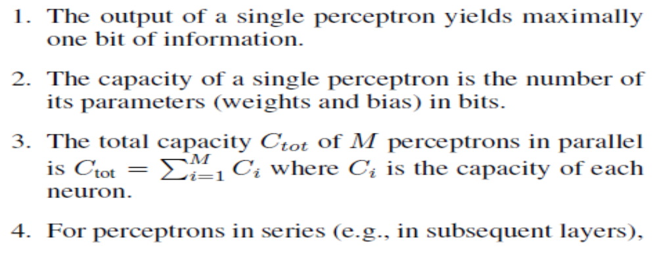
VC Dimension – Neural Nets -3
Rules to determine Maximum Capacity for Contemporary Neural Nets:
>> Continued in Next Slide

Slide 35
VC Dimension – Neural Nets -4
Rules to determine Maximum Capacity for Contemporary Neural Nets – Contd. :
Perceptron in Series:
For perceptrons in series, the capacity of a subsequent layer cannot be larger than the largest possible amount of information output of the previous layer.
Without loss of generality, we assume two layers of perceptrons. The output of perceptron layer 1 is the sole input for perceptron layer 2. We denote the total capacity of layer 2 with CL2, the number of parameters in layer 2 with kL2 and the number of bits in the output of layer 1 with oL1. Lemma 5.3 (Perceptrons in Series). CL2 = min(C(kL2), oL1)
Lemma 5.3 (Perceptrons in Series). CL2 = min(C(kL2), oL1)
Ref.: https://www.osti.gov/servlets/purl/1476219 -
A Practical Approach to Sizing Neural Networks - G. Friedland, M. Krell, A. Metere

Slide 36
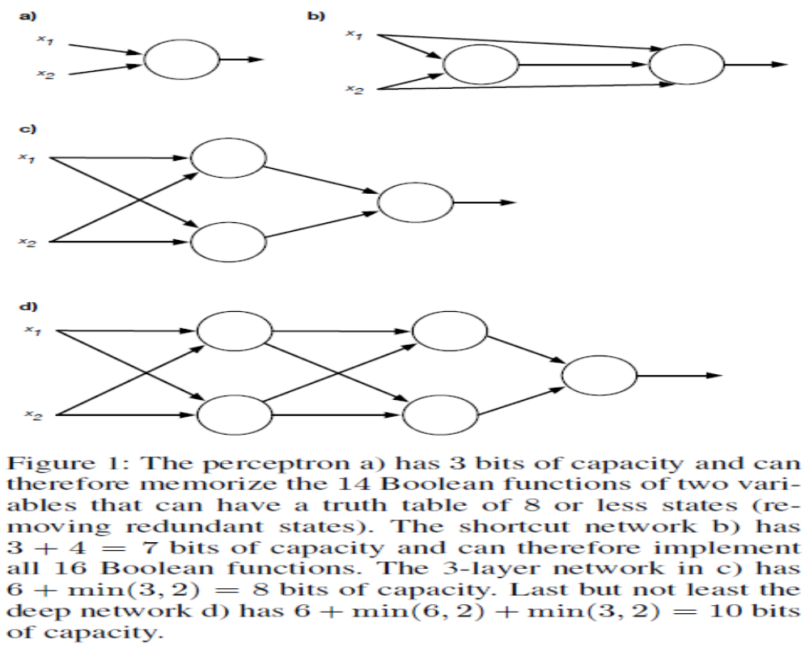
VC Dimension – Neural Nets Summary

Slide 37
How bits >= 5 learn all 16 functions
x1 | x2 | x3 | Final Out
0 | 0 | 0 | 0
0 | 1 | 1 | 1
1 | 0 | 1 | 0 - See note
1 | 1 | 0 | 1 - See note
NOTES:
X3 is the output of first gate i.e. input to the next gate. But the output of next gate for this input is changed to 0 (as we did it for a 3D case of perceptron to learn XOR).
Now we can classify the Final out using a linear classifier i.e. XOR is classified by a line using the 2 gates i.e. 5 bits of inputs.
5 bits are actually 3 bits: 2 bits at input (without bias) and 1 bit at the 2nd gate (without bias). 2 bits can create 4^2 = 16 functions. And now the 2 gates can classify all 16 functions of 2 input perceptron using lines.
MLP can use various other shapes to classify, e.g. a circle. So, it has more capacity to shatter and classify.

Slide 38
VC Dimension - Notes
For more on VCd refer to “Intro. to Neural Computation” by J. Hertz et al, Addison-Wesley, 1991 (book is old BUT the VCd derivation and analysis is good).
Also, VC Dimension will be more clear in the next lecture where we will cover SVM (Support Vector Machines).
SVM is built on the idea of VC Dimension.

